Slide 1
Build, Deploy and Administer Microservices using Kubernetes and IBM Cloud API Management
Please ensure you are connected to the ”Classroom” network with password “ibm-cas-19”
Workshop Content - https://github.com/cloud-coder/cascon-2019-kubernetes-apimanager/
Eric Charpentier, Neil Delima, Jason Mah, Darren Pape, Vince Yuen
Hands-on Workshop
Nov 5, 2019

Slide 2


Meet the Team
Application Consultant, Senior IT Specialist,
Certified Kubernetes Application Developer
IBM Software Adoption
Markham, Canada
Vince Yuen
Eric
Charpentier
Darren
Pape
Application Consultant, Project Manager
IBM Software Adoption
Markham, Canada
Senior Managing Consultant
IBM Software Adoption
Markham, Canada
Offering Manager
IBM Developer & Coder Program
Markham, Canada
Certified Senior IT Specialist
IBM Software Adoption
Markham, Canada
Jason
Mah
Neil
Delima

Slide 3
Agenda
Introduction:
Lab 1 – Preparation
Objective
An Introduction to Microservices, Docker and Kubernetes
Hands-On Labs:
Lab 2 – Build & Deploy Microservices (45-60 mins)
Lab 3 – Scaling the Services (20-30 mins)
Lab 4 – API Management (45 min)
Conclusion:
Q&A, Feedback Forms

Slide 4
Workshop Materials
https://github.com/cloud-coder/cascon-2019-kubernetes-apimanager

Slide 5
Lab 1 Setup Pre-Requisite
Create an IBM Cloud Account
Provision an Instance of the IBM Kubernetes Services
Download and install the IBM Cloud and kubectl Command Line tools
Login to IBM Cloud
Optionally install an editor such as VSCode and a REST API testing tool like cURL or Postman
https://github.com/cloud-coder/cascon-2019-kubernetes-apimanager/tree/master/01-setup

Slide 6
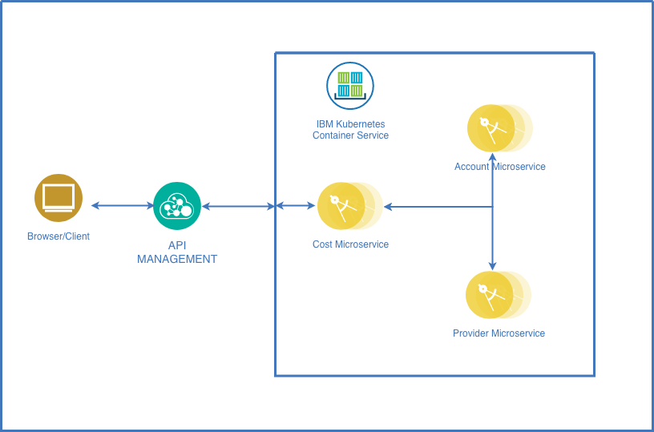
Workshop Objective
In this hands-on workshop:
Learn about Microservices, Kubernetes and API Management
Learn how to develop, containerize and deploy (multiple Node.js) microservices that communicate with each other to the IBM Kubernetes Container service
Learn how to secure and manage a REST end-point of the public service using API management
Build, Deploy, Scale and Secure 3 related Microservices

Slide 7
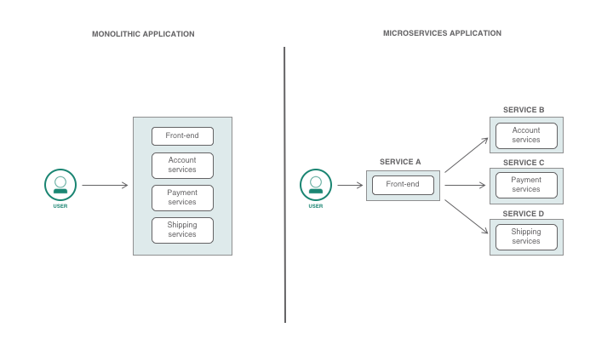
Introduction to Microservices
Microservices: An architectural pattern for building cloud native applications and de-composing monolithic applications into discrete, loosely coupled services.
Each microservice represents a different logical function for your application. Service independence permits faster development and changes to the application.
Services communicate with each other via RESTful interfaces.
https://developer.ibm.com/articles/why-should-we-use-microservices-and-containers/
Notes:
References:
https://developer.ibm.com/articles/why-should-we-use-microservices-and-containers/
https://www.ibm.com/cloud/garage/architectures/microservices/overview
https://developers.redhat.com/topics/microservices/
https://developer.ibm.com/technologies/microservices/
https://12factor.net/

Slide 8
Introduction to Microservices
Microservices Principles:
One job
Each microservice must be optimized for a single function resulting in services which are simpler, smaller and easier to write and maintain
Separate processes
Communication between microservices should be conducted through REST API and message brokers
CI/CD and DevOps
Continuously integrate and deliver each microservice independently
Resiliency
High availability clustering decisions can be applied to each microservice individually
Notes:
References:
https://www.ibm.com/cloud/garage/architectures/microservices/overview
https://12factor.net/
-Each microservice must be optimized for a single function. Each service is smaller and simpler to write, maintain, and manage. Robert Martin calls this principle the "single responsibility principle.”
-Communication between microservices must be conducted through REST API and message brokers. All communication from service to service must be through the service API or must use an explicit communication patter
-Although microservices can expose themselves through APIs, the focus is not on interfaces, but on the running components. The granularity of a microservices application is highlighted in this figure:
-Each microservice can be continuously integrated (CI) and continuously delivered (CD). When you build a large application that is composed of many services, you soon realize that different services evolve at different rates. If each service has a unique continuous integration or continuous delivery pipeline, the service can proceed at its own pace. In the monolithic approach, different aspects of the system are all released at the speed of the slowest moving part of the system.
-You can apply high availability and clustering decisions to each microservice. When you build large systems, another realization that you have is that when it comes to clustering, one size does not fit all. The monolithic approach of scaling all the services in the monolith at the same level can lead to the overuse or underuse of services. Even worse, when shared resources are monopolized, services might be neglected. In a large system, you can deploy services that do not need to scale to a minimum number of servers to conserve resources. Other services require scaling up to large numbers.

Slide 9
Introduction to Microservices
The Benefits of a Microservices Architecture:
Faster development and deployment cycle for each microservice
Development Efficiency: Each team works on a service independently using the most suitable and efficient tech stack
Scalability: Increase capacity per microservice as the demand grows
Encourages CI/CD of individual microservices into production
Data can be decentralized
The Drawbacks of a Microservices Architecture:
Added layer of complexity in building, versioning, testing, deploying and maintenance.
Monitoring, Logging and Debugging is more involved.
Notes:
References:
https://developer.ibm.com/articles/why-should-we-use-microservices-and-containers/
https://www.ibm.com/cloud/garage/architectures/microservices/overview
https://developers.redhat.com/topics/microservices/
https://developer.ibm.com/technologies/microservices/
https://12factor.net/

Slide 10
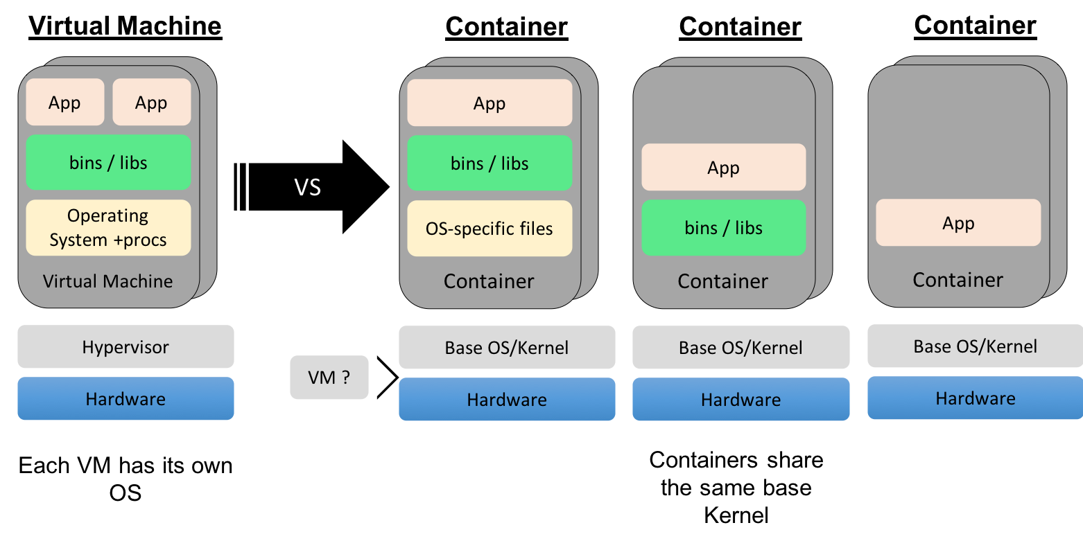
Introduction to Containers
Containers are processes running in isolation. It packages all code and dependencies so that applications run reliably between environments.
Containers include everything needed to run the processes within them, so there is no need to install additional dependencies directly on your host.
Docker is the most common container runtime
Why Use Containers:
Ease of packaging a microservice and its dependencies such as runtime libraries
Lower space and memory footprint and faster to boot time compared to VMs.
Consistent environment across development lifecycle.
Process level isolated runtime environment achieved via namespaces
Notes:
References:
https://github.com/IBM/kube101/tree/master/workshop
https://containerd.io/
https://coreos.com/rkt/
https://www.docker.com/

Slide 11
Introduction to Docker
What is Docker?
Tooling to build and manage containers
Docker creates and manages the lifecycle of containers
Setup filesystem
CRUD container
Setup networks
Setup volumes / mounts
Create: start new process telling OS to run it in isolation
Docker Components:
Docker client and server: Docker CLI and the Docker daemon process
Docker image: Defined by a Docker file and comprising of image layers that built on each other.
Docker registry: A Docker image repository ex. Docker Hub, IBM Cloud Container Registry
Docker container: An executable package of an application and its dependencies.
Notes:
References:
https://github.com/IBM/kube101
https://www.simplilearn.com/docker-tutorial-article
https://docs.docker.com/engine/docker-overview/

Slide 12
Introduction to Kubernetes
What is Kubernetes (K8s/Kube)?
Container Orchestrator
Provision, manage, scale containerized applications within a cluster of Nodes
Manage the lifecycle of containerized applications
Manage infrastructure resources needed by applications
Volumes
Networks
Secrets
Declarative model
Provide the "desired state" and Kubernetes will make it happen
IBM Kubernetes Service (IKS) and IBM Cloud Container Registry (ICCR) are IBM packaged versions of Kubernetes and a Docker/OCI compliant container registry
Notes:
Notes:
Kubernetes is a container orchestrator to provision, manage, and scale applications i.e. manage the lifecycle of containerised applications within a cluster of Nodes.
Your applications need many other resources to run such as Volumes, Networks, Secrets that will help you to do things such as connect to databases, talk to firewalled backends, and secure keys. Kubernetes helps you add these resources into your application.
Infrastructure resources needed by applications are managed declaratively.
The key paradigm of kubernetes is it’s Declarative model. The user provides the "desired state" and Kubernetes will make it happen. If you need 5 instances, you do not start 5 separate instances on your own but rather tell Kubernetes that you need 5 instances and Kubernetes will reconcile the state automatically. Simply at this point you need to know that you declare the state you want and Kubernetes make that happen, if something goes wrong with one of your instances and it crashes, Kubernetes still knows the desired state and restores the crashed instance on an available node.
References:
https://github.com/IBM/kube101
https://cloud.ibm.com/docs/services/Registry?topic=registry-registry_overview
https://cloud.ibm.com/docs/containers?topic=containers-getting-started

Slide 13
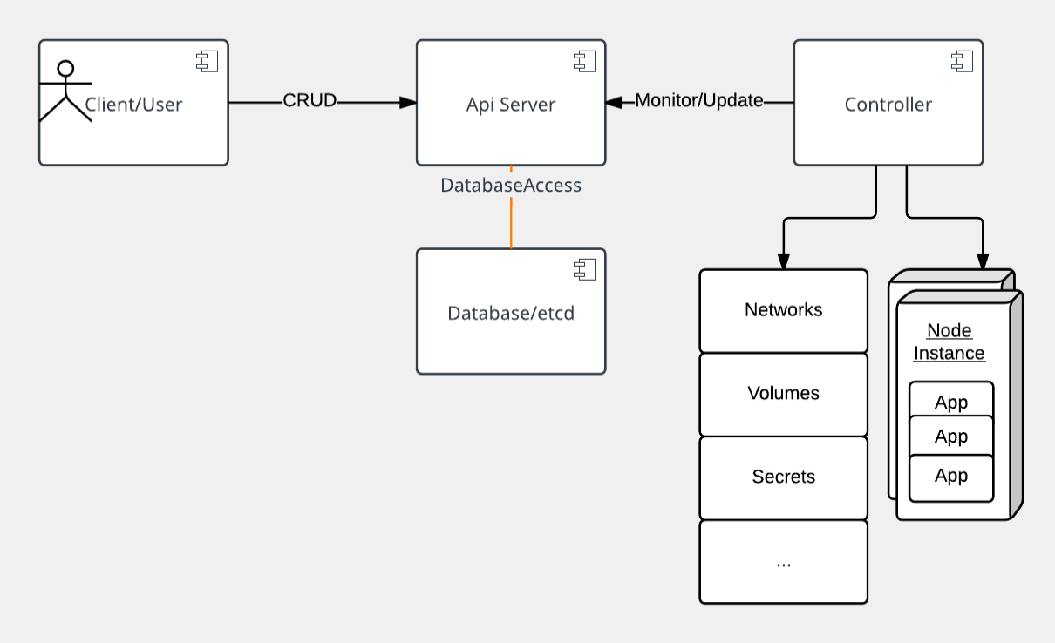
Kubernetes Architecture
At its core, Kubernetes is a database (etcd).
The declarative model is stored in the data store as objects
Watchers watch for changes to the DB and Controllers then react to the model and attempt to take action to achieve the desired state
API server is a simple HTTP server handling CRUD operations on the DB.
Controllers pick up a change and instantiate the actual Kubernetes declared resource
Notes:
Notes:
At its core, Kubernetes is a data store (etcd). The declarative model is stored in the data store as objects, that means when you say I want 5 instances of a container then that request is stored into the data store. This information change is watched and delegated to Controllers to take action. Controllers then react to the model and attempt to take action to achieve the desired state. The power of Kubernetes is in its simplistic model.
As shown, API server is a simple HTTP server handling create/read/update/delete(CRUD) operations on the data store. Then the controller picks up the change you wanted and makes that happen. Controller are responsible for instantiating the actual resource represented by any Kubernetes resource. These actual resources are what your application needs to allow it to run successfully.
References:
https://kubernetes.io/docs/home/
https://kubernetes.io/docs/concepts/
https://github.com/IBM/kube101

Slide 14
Kubernetes Resources
A Kubernetes app defines a collection of resources which are monitored and processed by the Controller. Here are some key resources
Config Maps holds configuration data for pods to consume.
Deployments defines a desired state of a deployment object
Endpoints allows a inbound connections to reach the cluster services
Ingress is a collection of rules that allow inbound connections to reach the cluster services
Node is a worker machine in Kubernetes
Namespaces are multiple virtual clusters backed by the same physical cluster
Pods are the smallest deployable units of computing that can be created and managed in Kubernetes
Replica Sets ensures that a specified number of pod replicas are running at any given time
Services is an abstraction which defines a logical set of Pods and a policy by which to access them - sometimes called a micro-service.
Jobs creates one or more pods and as they complete successfully the job is marked as completed.
Notes:
Notes:
Each resource is monitored and processed by a controller. When you define your application, it contains a collection of these resources. This collection will then be read by Controllers to build your applications actual backing instances. Some of resources that you may work with are listed below for your reference, for a full list you must go to https://kubernetes.io/docs/concepts/. In this class we will only use a few of them, like Pod, Deployment, etc.
References:
https://kubernetes.io/docs/concepts/
https://github.com/IBM/kube101

Slide 15
Kubernetes Resources
Notes:
Reference:
https://kubernetes.io/docs/tutorials/kubernetes-basics/

Slide 16
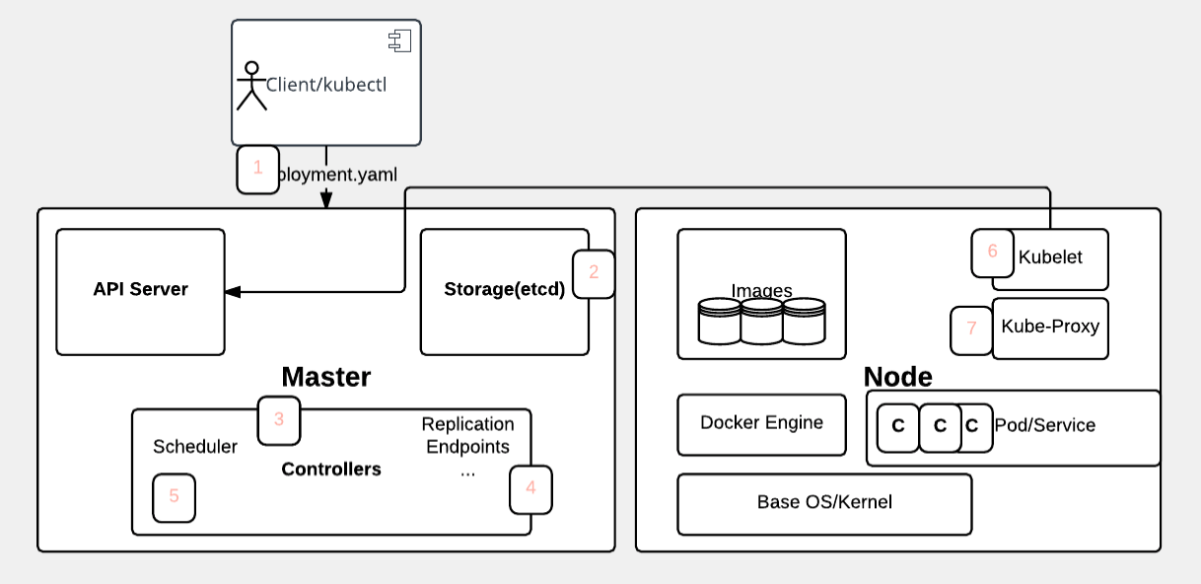
Kubernetes application deployment workflow
Notes:
Notes:
1. User via "kubectl" deploys a new application. Kubectl sends the request to the API Server.
2. API server receives the request and stores it in the data store (etcd). Once the request is written to data store, the API server is done with the request.
3. Watchers detects the resource changes and send a notification to controller to act upon it
4. Controller detects the new app and creates new pods to match the desired number# of instances. Any changes to the stored model will be picked up to create or delete Pods.
5. Scheduler assigns new pods to a Node based on a criteria. Scheduler makes decisions to run Pods on specific Nodes in the cluster. Scheduler modifies the model with the node information.
6. Kubelet on a node detects a pod with an assignment to itself, and deploys the requested containers via the container runtime (e.g. Docker). Each Node watches the storage to see what pods it is assigned to run. It takes necessary actions on resource assigned to it like create/delete Pods.
7. Kubeproxy manages network traffic for the pods – including service discovery and load-balancing. Kubeproxy is responsible for communication between Pods that want to interact.
References:
https://github.com/IBM/kube101/

Slide 17
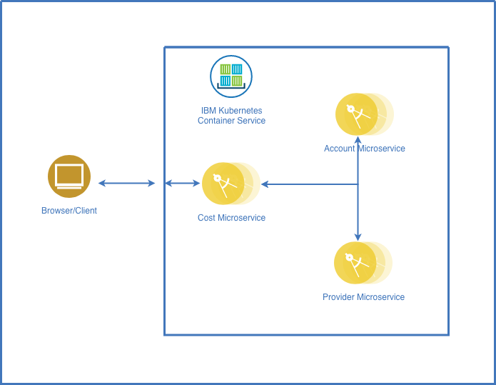
Lab 2 Explore Kubernetes and Create a Kubernetes Service Deployment (45-60 mins)
Account, Provider and Cost microservice images
Predefined services for the lab which demonstrate the microservices architecture

Slide 18
Lab 2 Explore Kubernetes and Create a Kubernetes Service Deployment (45-60 mins)
Create images for the Account, Provider and Cost services
Create containers and deploy them to the Kubernetes cluster using IBM Cloud
Expose the API outside of the cluster
Test the functionality of the API
https://github.com/cloud-coder/cascon-2019-kubernetes-apimanager/tree/master/02-kubernetes-service-creation

Slide 19
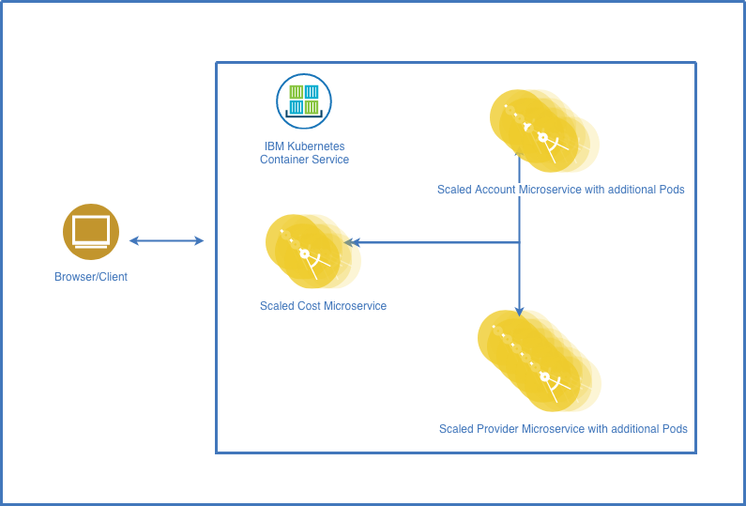
Lab 3 Scaling Applications in Kubernetes (20-30 mins)
Learn how to horizontally scale your microservice by adding replicas
Using a kubectl command
By modifying the deployment configuration
By modifying the deployment configuration via the Kubernetes Dashboard
Validate that your microservices have been scaled
https://github.com/cloud-coder/cascon-2019-kubernetes-apimanager/tree/master/03-scaling-in-kubernetes

Slide 20
Lab 4 API Management
IBM API Management can be accessed at https://cloud.ibm.com/apis/overview
Two tiered approach to API Management (Full API Connect and Lite API Management)
IBM API Management integrated into IBM Cloud allows you to:
Create, manage, and monitor your APIs using a simple interface
Limit access only to clients who are allowed
Control usage by limiting usage to specific rates
Supports limited number of API Keys (Lite version)

Slide 21
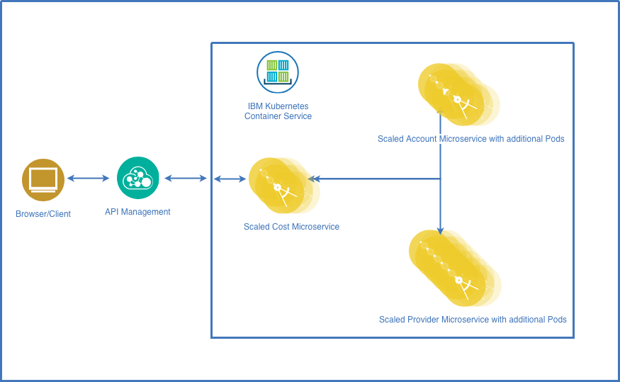
Lab 4 API Management (45 mins)
Add endpoints in IBM Cloud API Management for services deployed in Kubernetes
Add security to services using API keys
Rate limiting for an API
https://github.com/cloud-coder/cascon-2019-kubernetes-apimanager/tree/master/04-api-management

Slide 22
Conclusion
Microservice Architecture
Architectural pattern encouraging small, single purpose, independent services
Microservices are more maintainable and individually managed/deployable
Docker and Kubernetes
Build applications into images and deploy those applications as containers
Kubernetes provides a declarative container orchestration engine
IBM Cloud provides IBM Kubernetes Service as both Free Tier and Paid Tier options
Manage Kubernetes cluster using CLI tools or Kubernetes Dashboard
IBM API Management
Built in API Management in IBM Cloud
Allowing for microservices to be built or proxied, secured and rate limited through a web interface

Slide 23
Conclusion
Reference Links:
Lab Content - https://github.com/cloud-coder/cascon-2019-kubernetes-apimanager/
Kubernetes Command Reference - https://kubernetes.io/docs/reference/generated/kubectl/kubectl-commands
IBM Cloud Kubernetes Service - https://cloud.ibm.com/docs/containers?topic=containers-getting-started

Slide 24
Questions
Thank you for attending!

